Slide 1
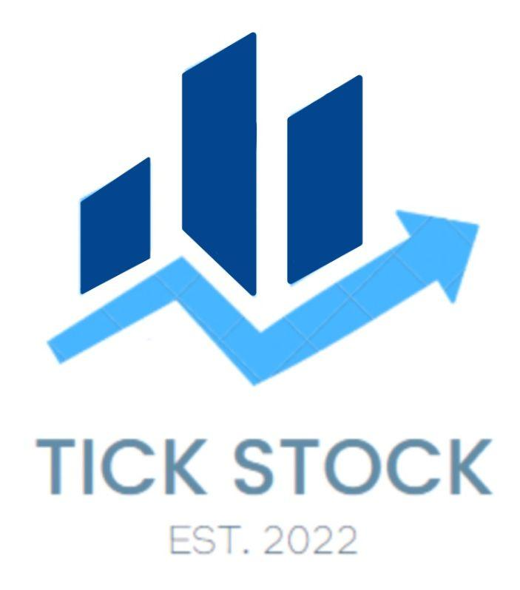
Los Perros
EC 327 - Project Architecture
Tick Stock
Kai Imery, John Culley, Ruben Carbajal, José Batlle

Slide 2
TEAM
-
-
-
-
John culley
Kai imery
Project Lead
Technical/Interface Lead
Ruben carbajal
José Batlle
Documentation Lead
Specification Lead

Slide 3
Program structure
User interface
Website back end
JavaScript
React
HTML
CSS
API Polygon.io
API Finnhub

Slide 4
USER INterface

Slide 5
Why react js?
Is free and open source
ideal since it comes with a lot of packages to help structure a website and start running on our local host
Remarkably flexible
Used in industry
Has multiple supporting resources

Slide 6
Website back end

Slide 7
Why polygon.IO?
Allows us to query the latest market data from all us stock exchange and information about the company itself
Free access to reference data
It works great with websites and specifically javascript

Slide 8
Design criteria
Quick and easy to navigate
Simple Design
Intuitive

Slide 9
Main screen
we created a minimalistic design that highlights a stock's recent behavior, short description, a ticker, various price information , and the latest news surrounding that company
we divided the components into four sections, those being the header, aggregate, details, and news

Slide 10
Overall process
1
2
3
Take the user input of respective stock
Send data to the polygon api and fetch the appropriate JSon response
Display the generated data

Slide 11
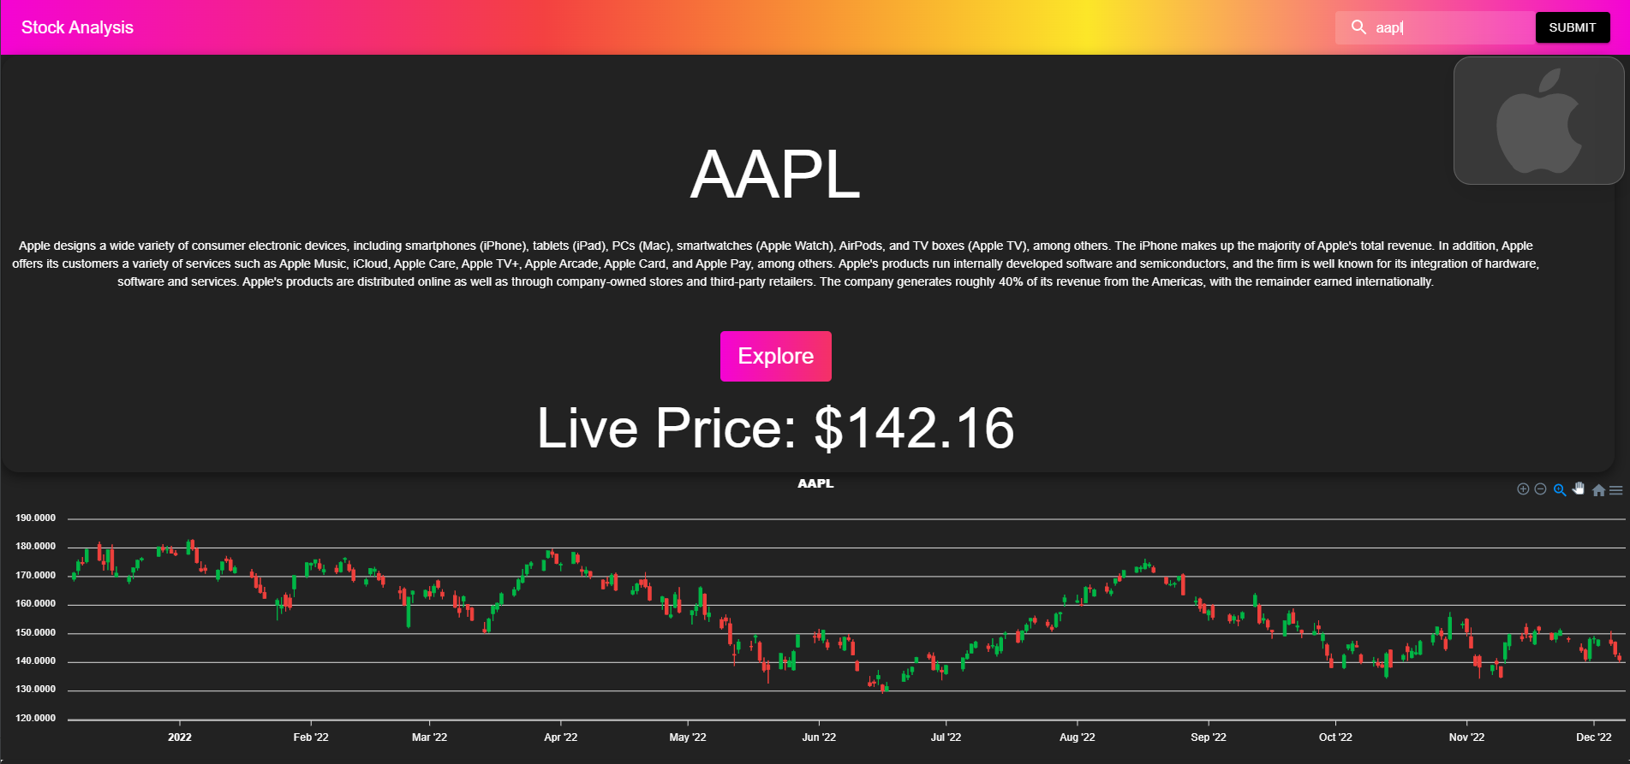
Header - Feature
This AppBar has the title on the left, and then a search bar on the right side

Slide 12
Header - Function calls
FRONT END
bACK END
App bar
Import components
inputhandler()
The script first renders a search bar with an AppBar
From the MUI/ Material Library, as well as the Axios, useEffect, and useState hooks from react
Takes the user’s input and converts it to lowercase
renders
handlesubmit()
search()
Renders the AppBar with a search bar, a submit button, and a Typography component
checks if the user’s input is a stock ticker and stores it in the stock variable
Takes in the user’s input

Slide 13
aggregate - Feature
holds the purpose of displaying a image, brief summary, and candlestick chart of stock’s data

Slide 14
aggregate - Function calls
FRONT END
bACK END
useeffect()
getstocks()
Set the series state variables with the data returned from the API
Uses the fetch() method to make a request to the API URL
renders
A candlestick chart using the Chart component from react-ApexCharts
aggregate()
import
Uses the useState() hook to set up two state variables (series and price) and (pastPrice and priceTime)
The Axios and chart libraries from react-Apexcharts and data from 2 APIs

Slide 15
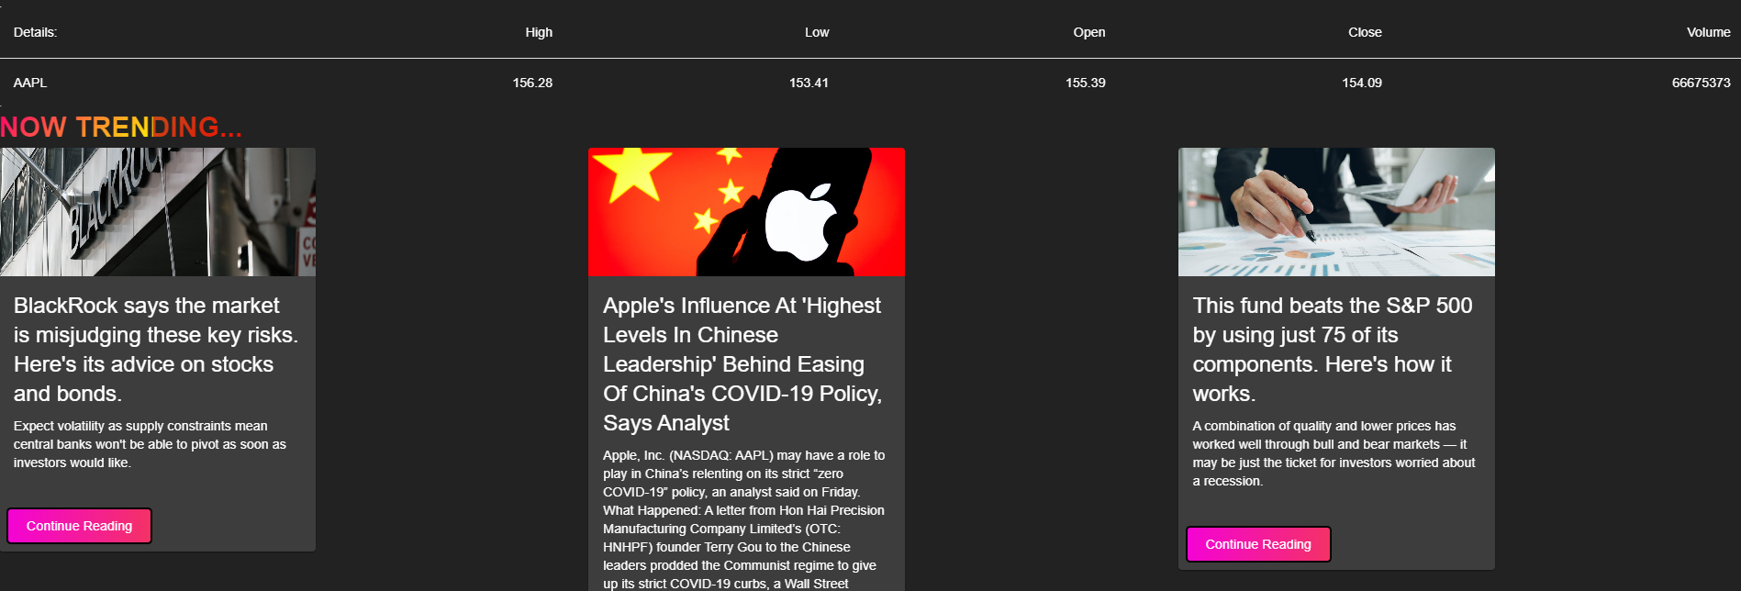
details - Function calls
holds the purpose of fetching data from the API and putting it in a table

Slide 16
details - Function calls
FRONT END
bACK END
HTTP
fetch()
It request to that URL using the fetch() function to get a JSON response
Get a request to the API for the JSON response
tablevals
Used to render a UI table to display the information
gettablevals()
useeffect()
Takes query and uses it to build an API endpoint URL
Fetch data from the API when the details component is mounted

Slide 17
News - feature
holds the purpose of displaying recent news of a given company

Slide 18
news - Function calls
FRONT END
bACK END
Material ui
getnews()
fetch()
Fetches news data from the Polygon API and displays it in a grid of cards with three columns
Tales query as a parameter and uses it to build the URL for the Polygon API
Get a request to the API for the JSON response
news()
useeffect()
News data
Calls the getNews() function and update newsdata state variable with the SPI response
Mapped over to create a grid of new cards, with three columns
Is created and it also takes query as a parameter, and it is passed into getNews()

Slide 19
thanks!

